Slide 1
More Power
To The Apps!
Hiram Fleitas
Download: github.com/hfleitas/pbifest2019

Slide 2
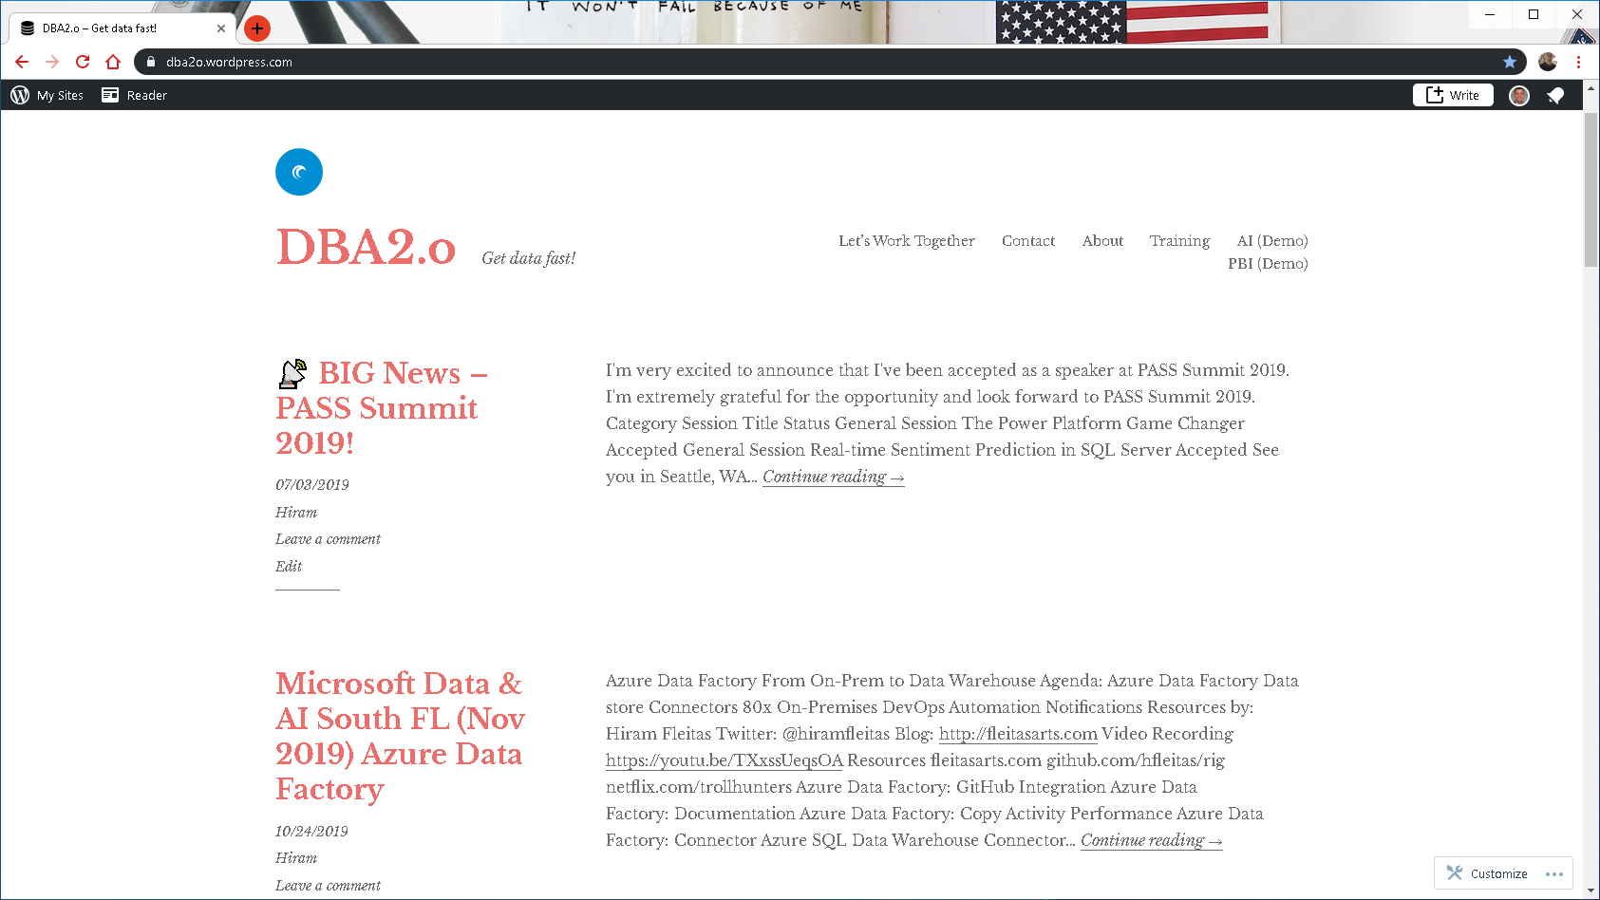

Slide 3
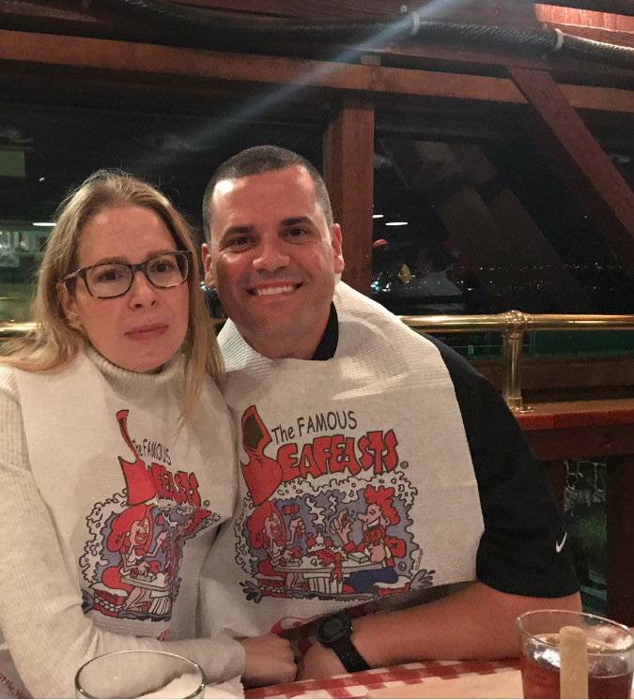

Link to Eval:
bit.ly/pbifest19
Your participation is very important.

Slide 4











Hiram Fleitas
Owner, Fleitas Arts
Bio
Father
Developer since 1995
SQL Server since 1999
Fleitas Arts, LLC since 2008
USCG Auxiliary Flotilla Staff Officer
@hiramfleitas
/hfleitas
hiram@fleitasarts.com
hiramfleitas
fleitasarts.com

Slide 5
Agenda
Ai Builder (Forms)
Row-Level-Security (RLS)
Approvals
ISS HTTP Web API
Power Virtual Agents

Slide 6
Forms – Ai builder
one

Slide 7
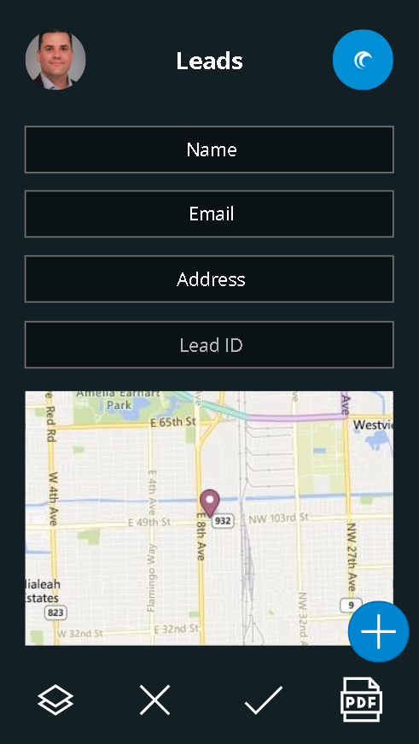

Slide 8
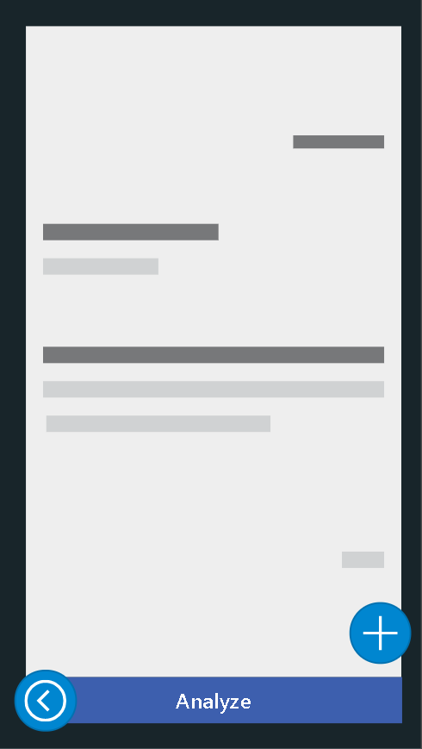
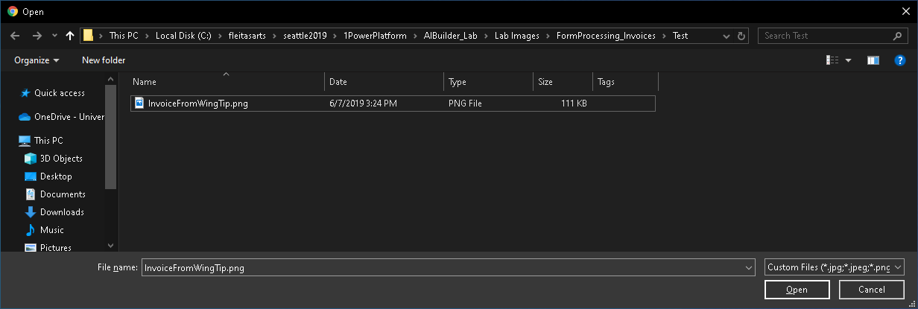

Slide 9
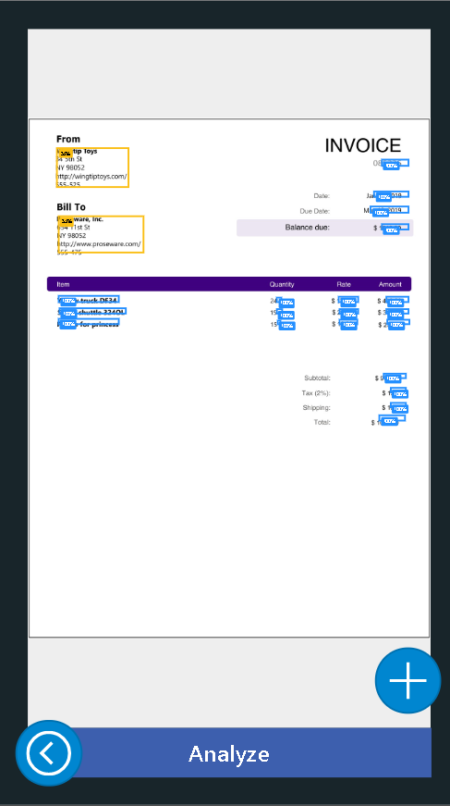

Slide 10
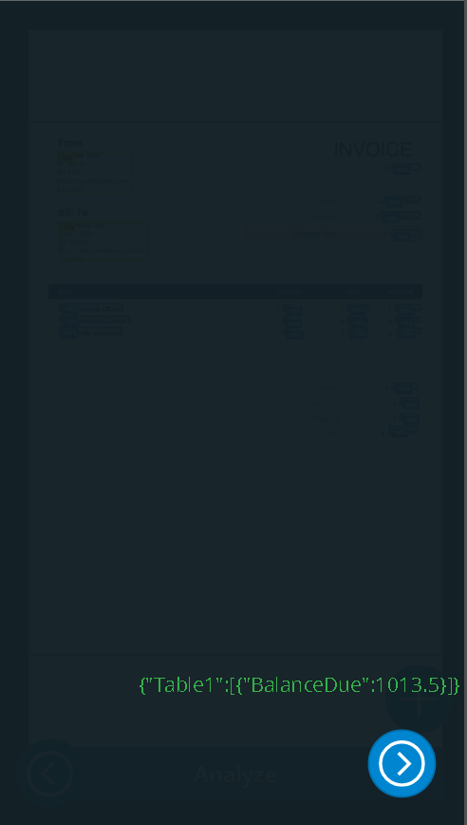

Slide 12
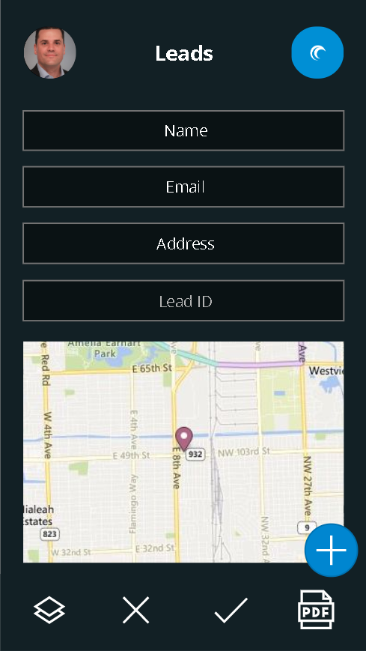

Slide 13


Slide 14


Slide 15
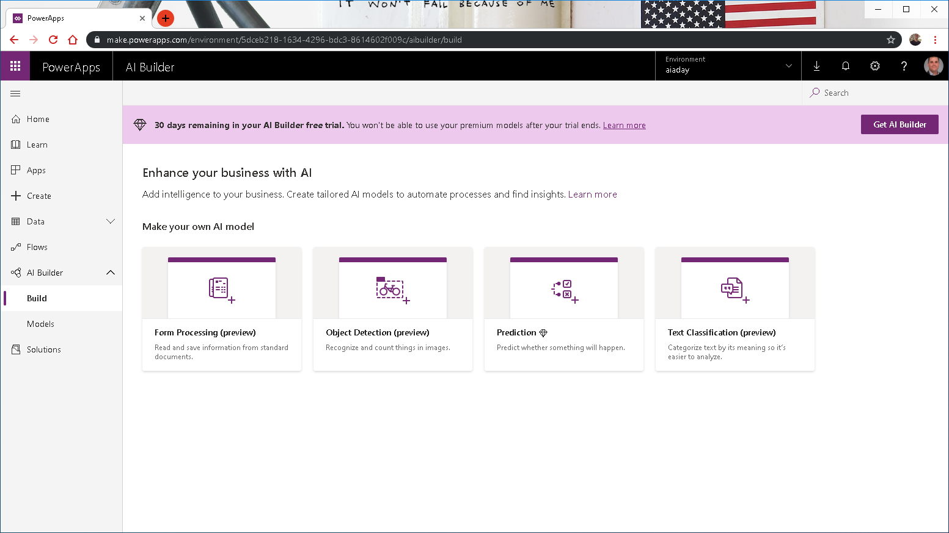

Slide 16
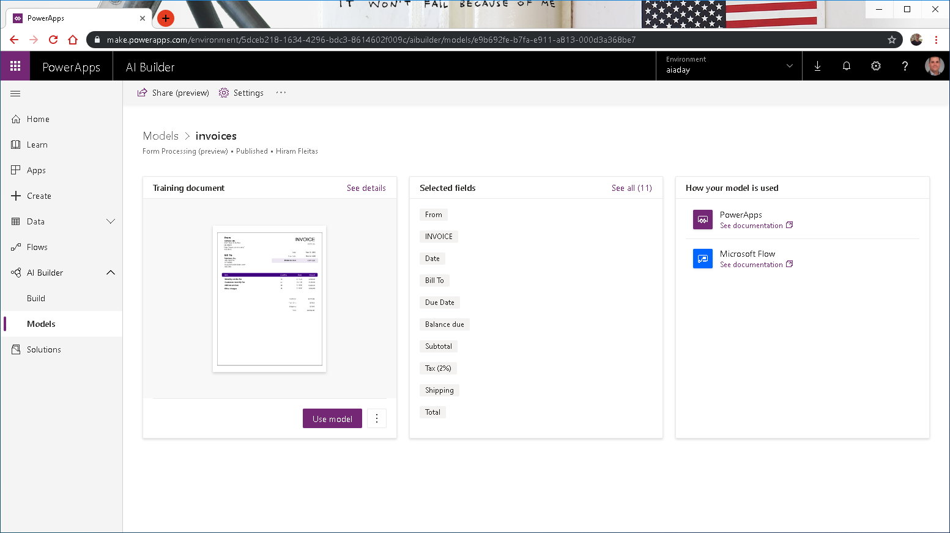

Slide 17
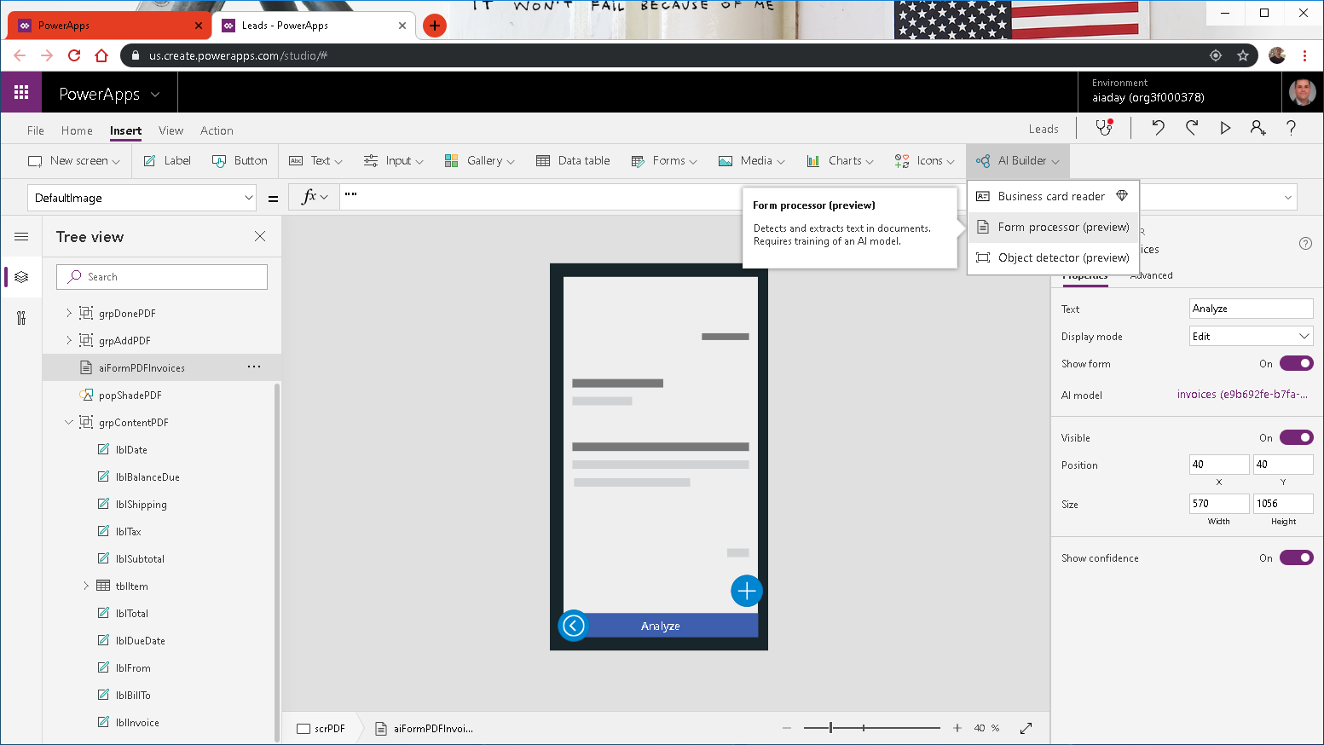

Slide 18
Row-Level-Security (RLS)
two

Slide 19
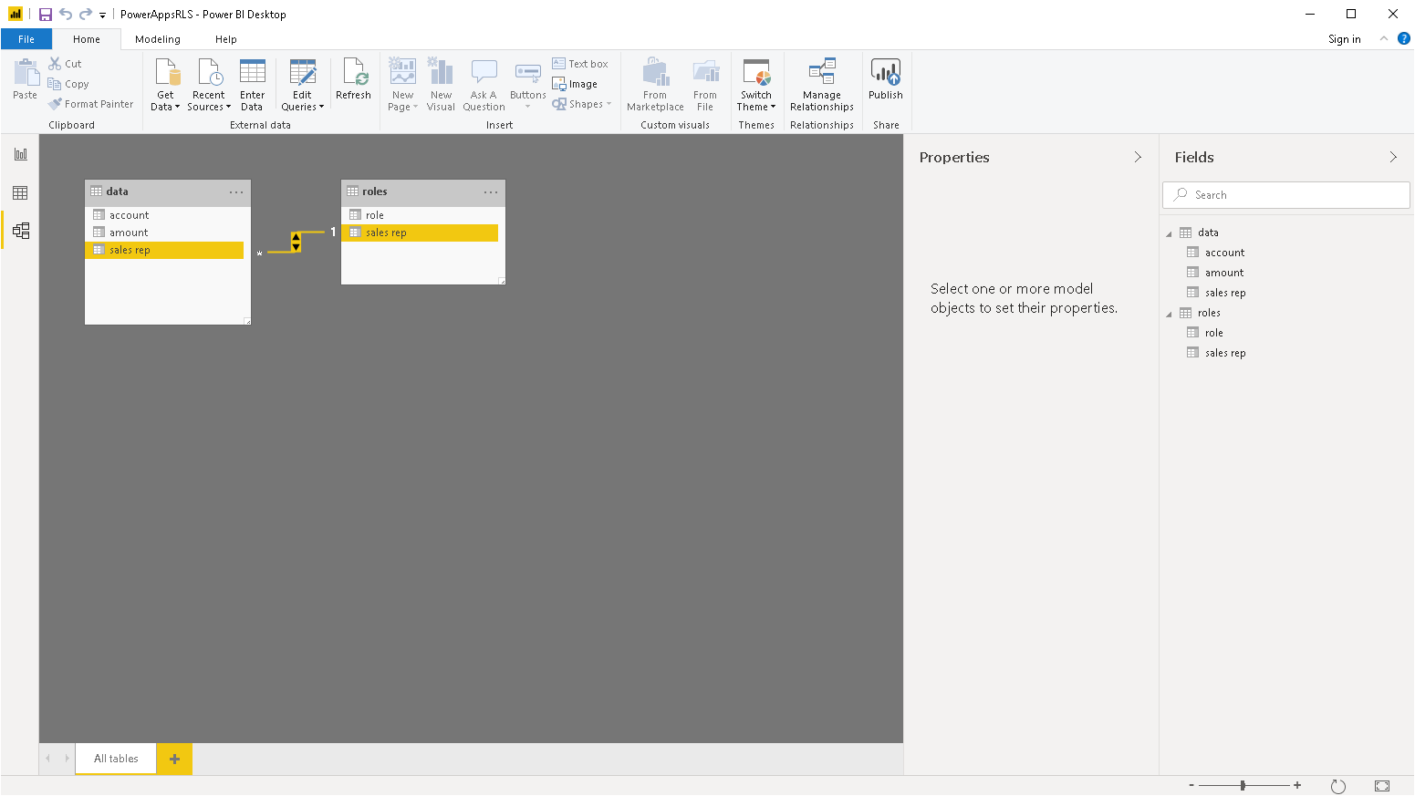
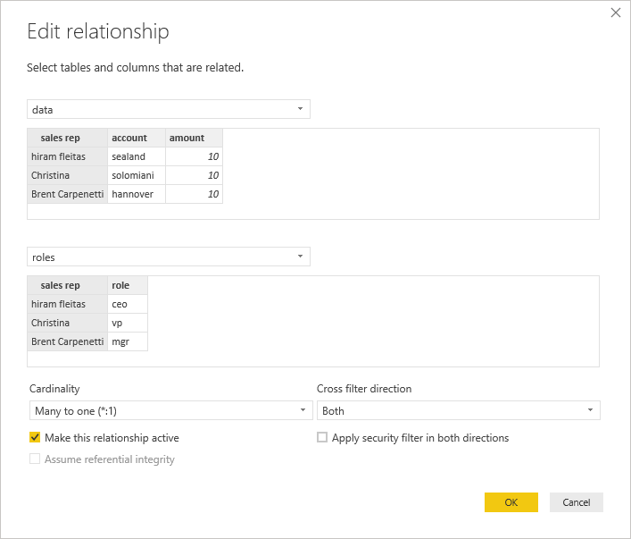

Slide 20
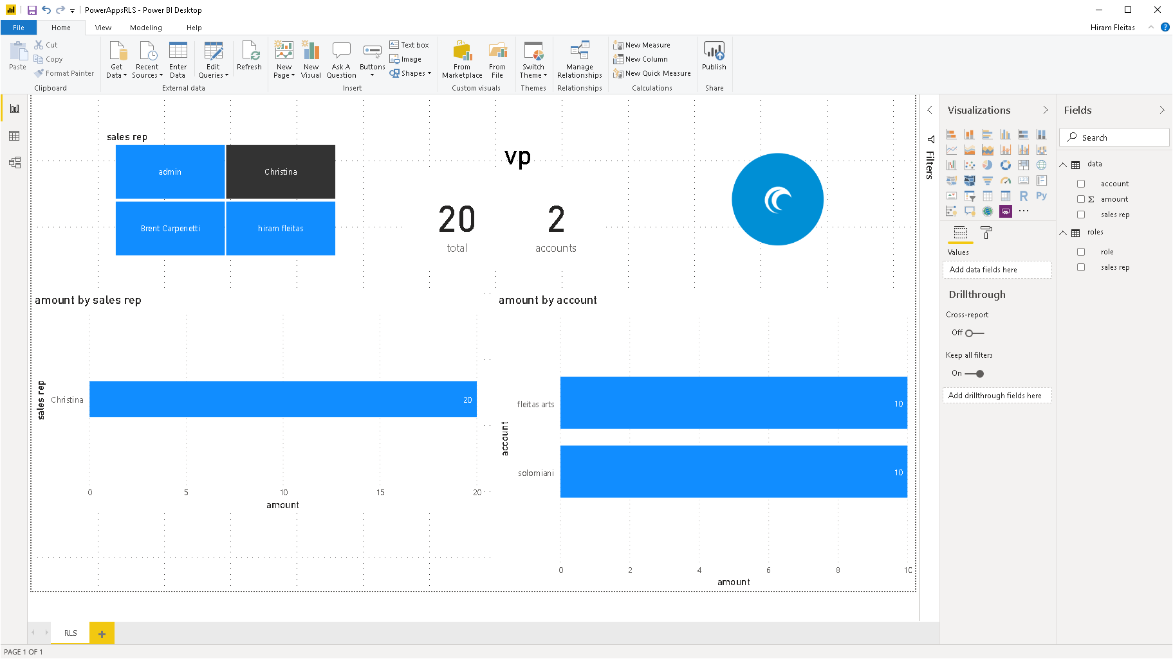

Slide 21
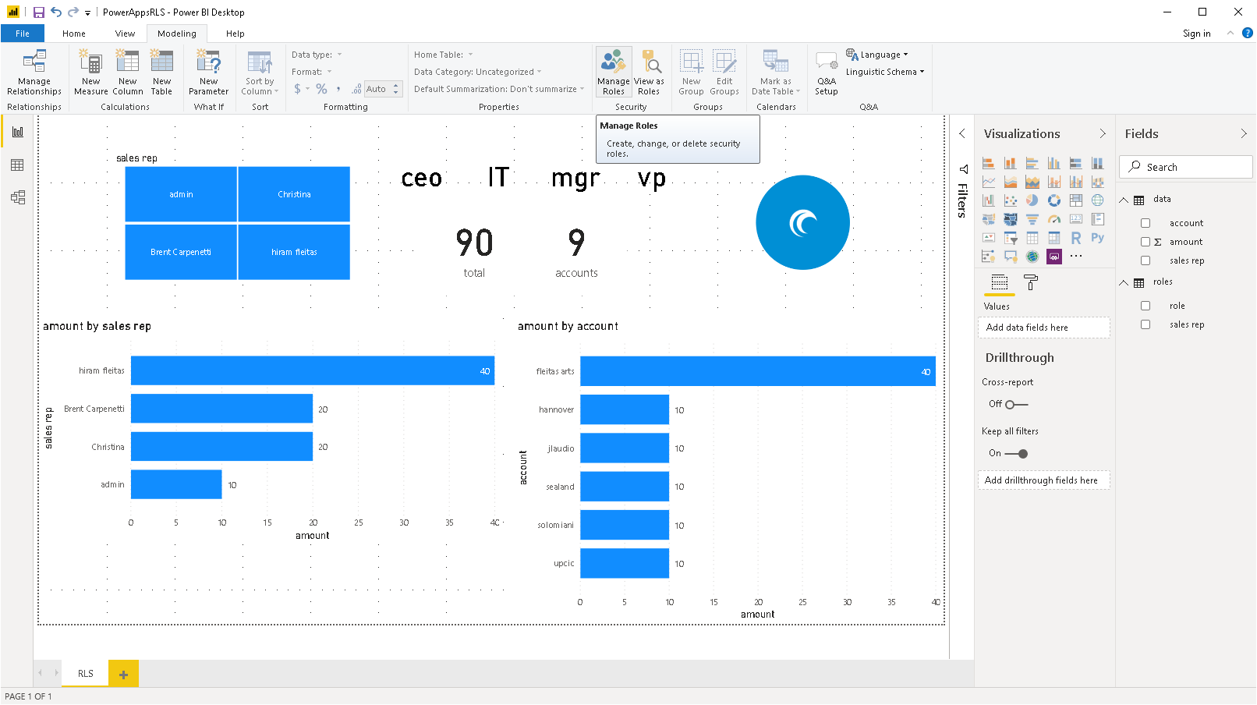

Slide 22
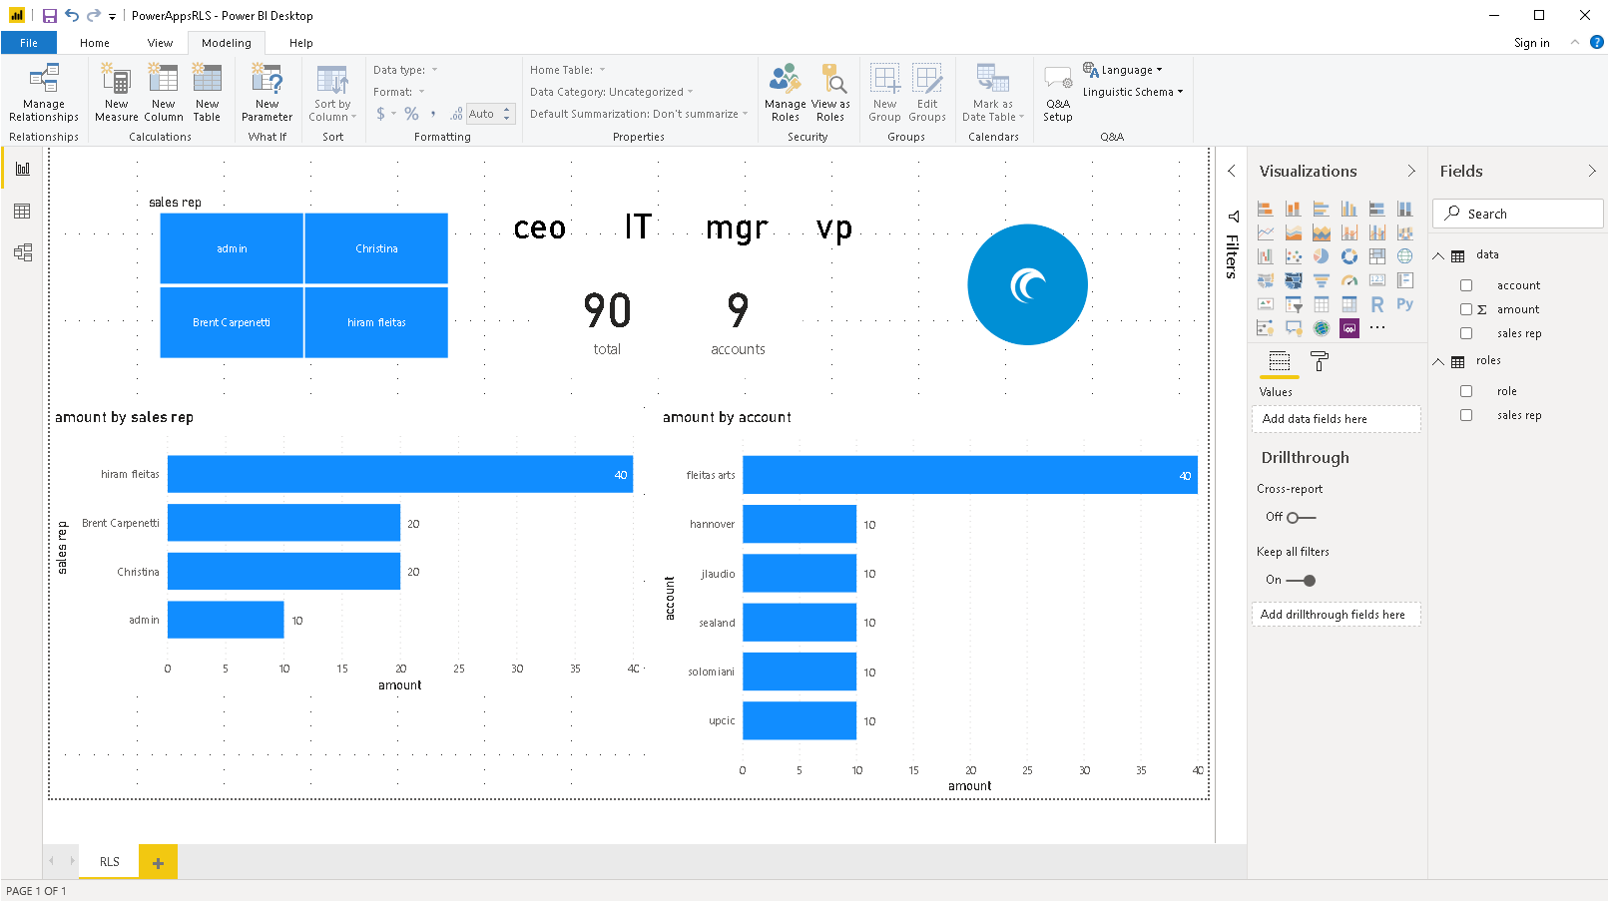
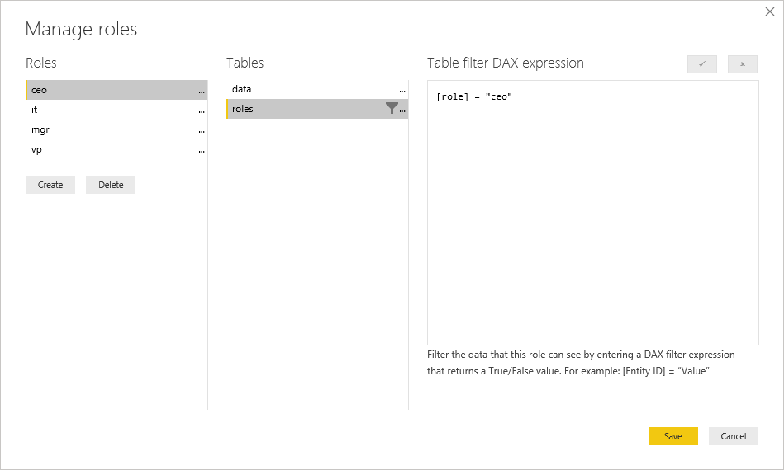
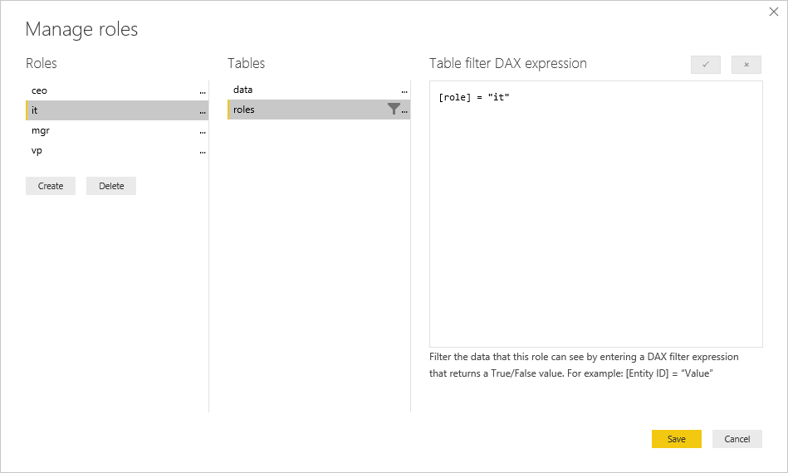
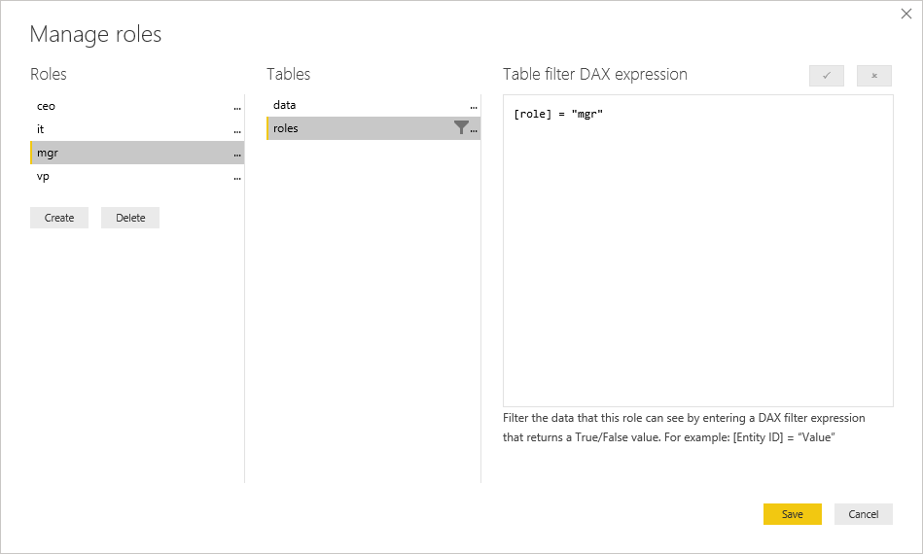
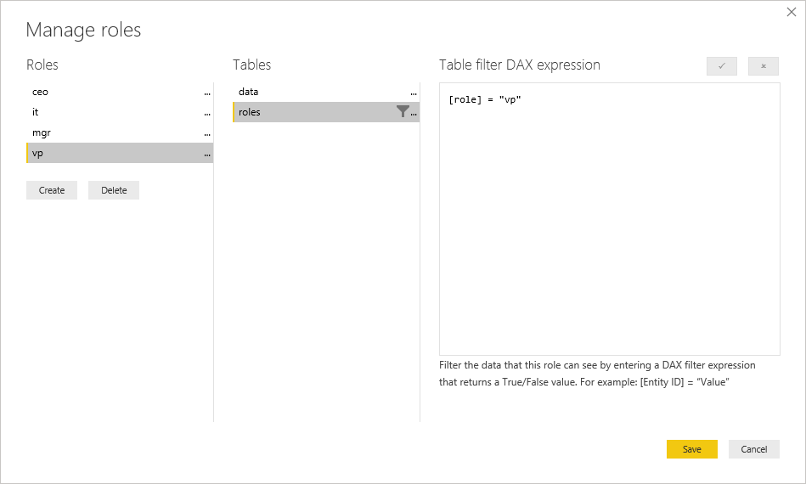

Slide 23
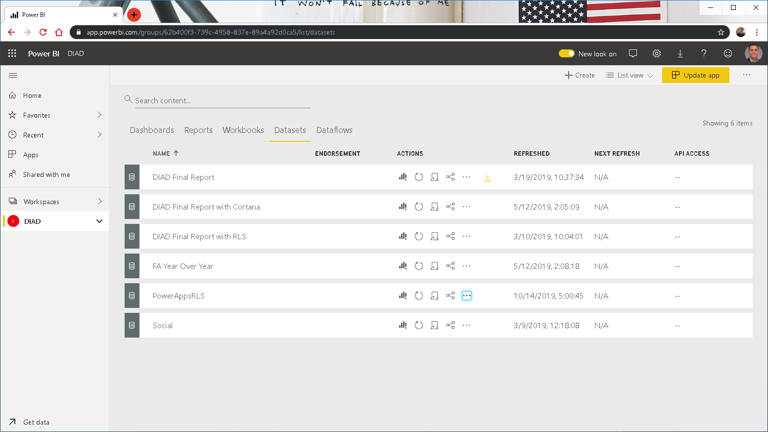

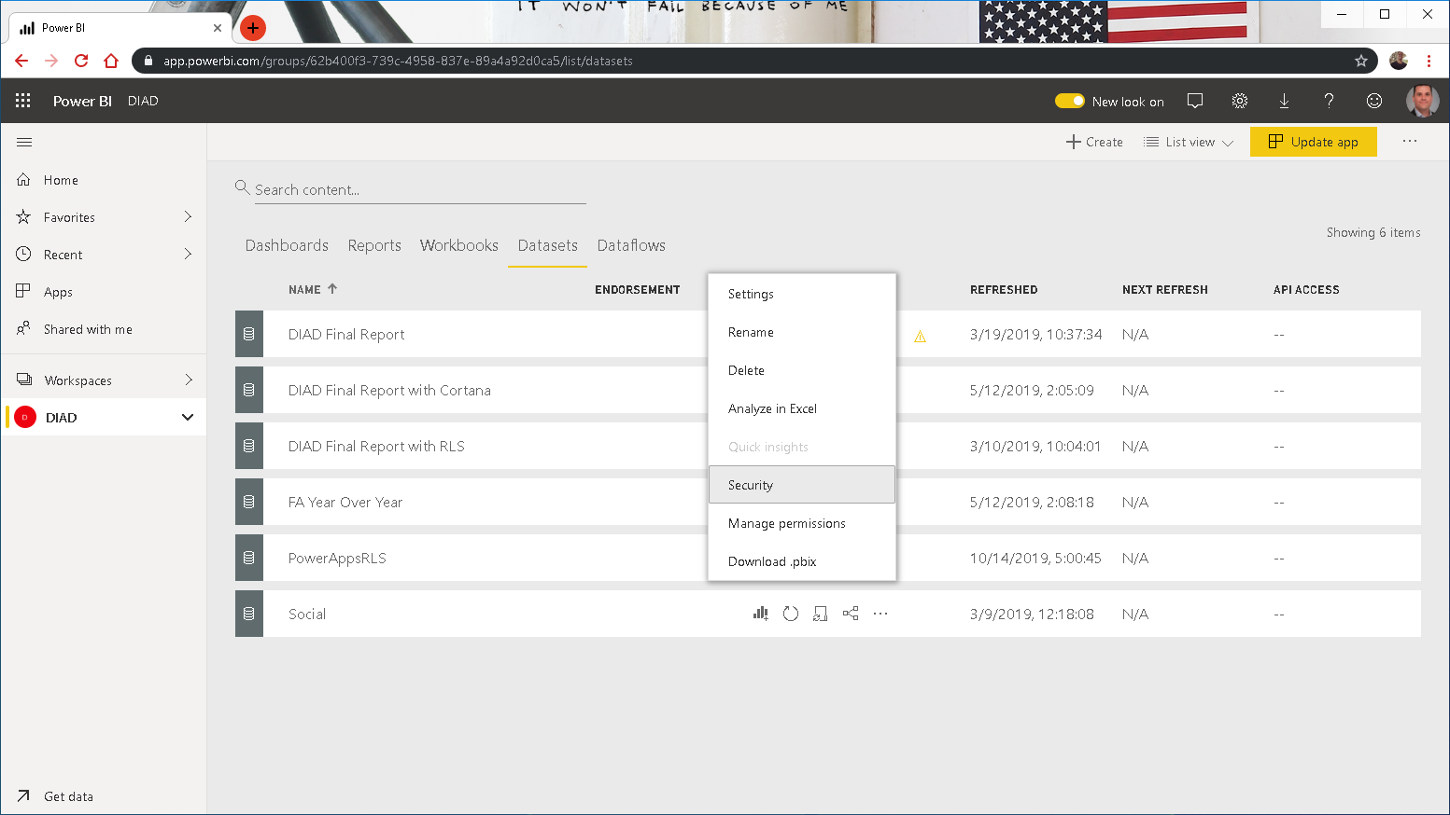

Slide 24
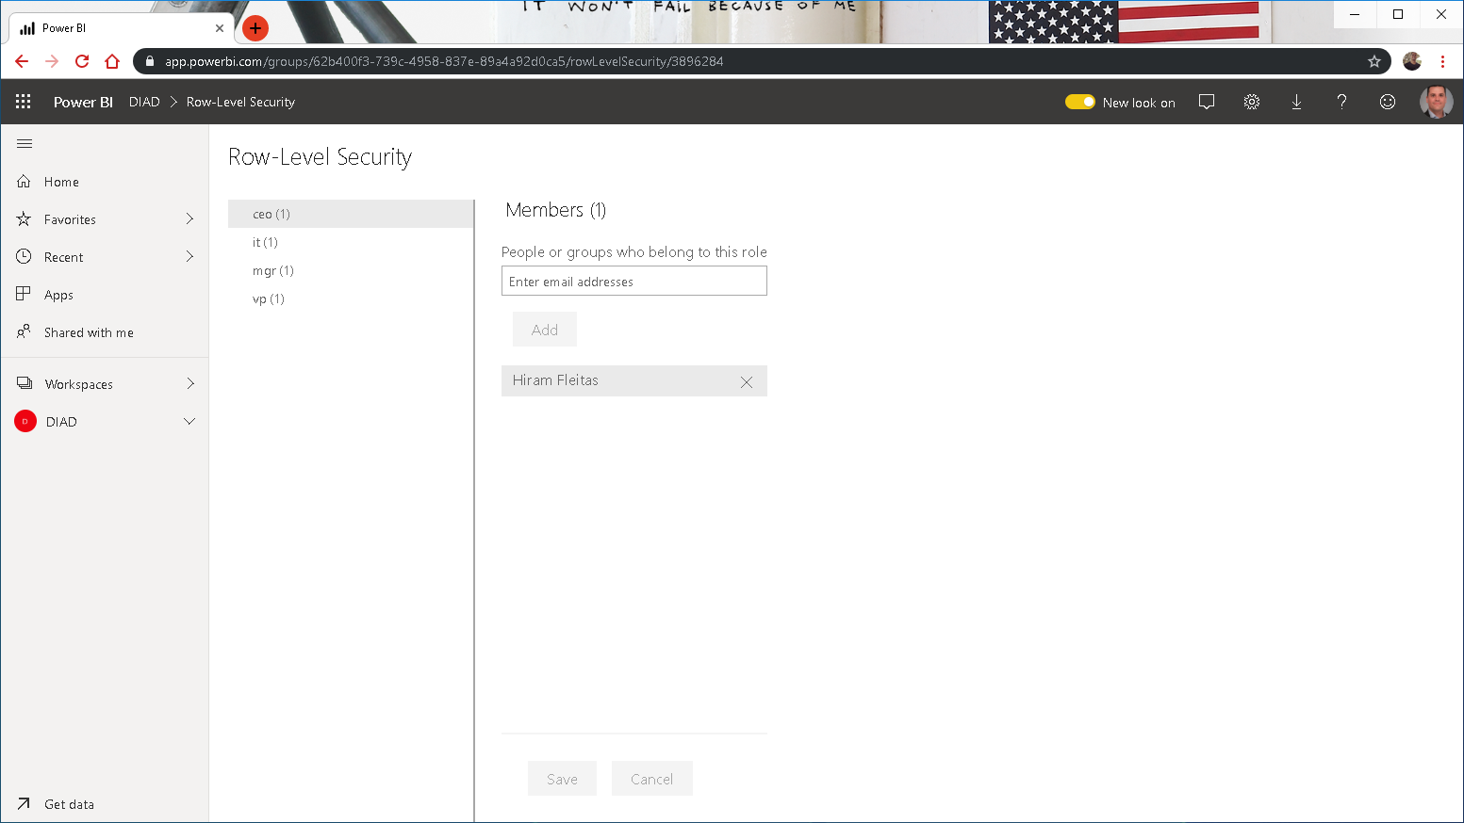




Slide 25
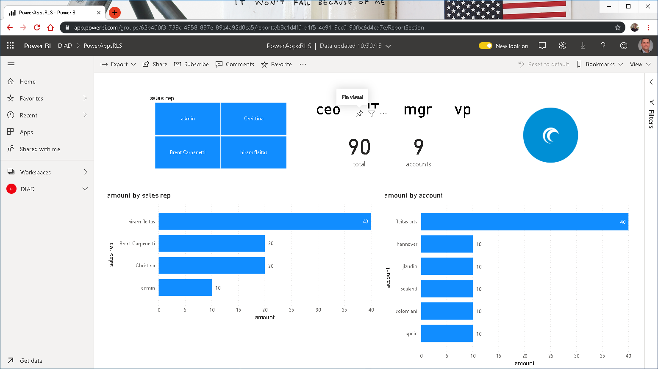

Slide 26
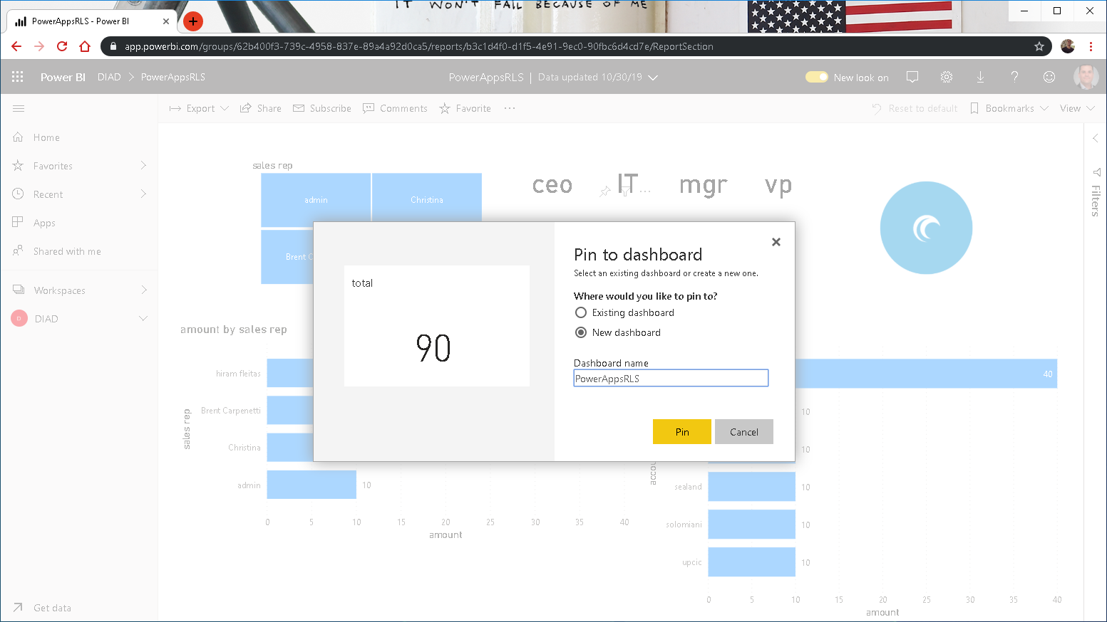

Slide 27
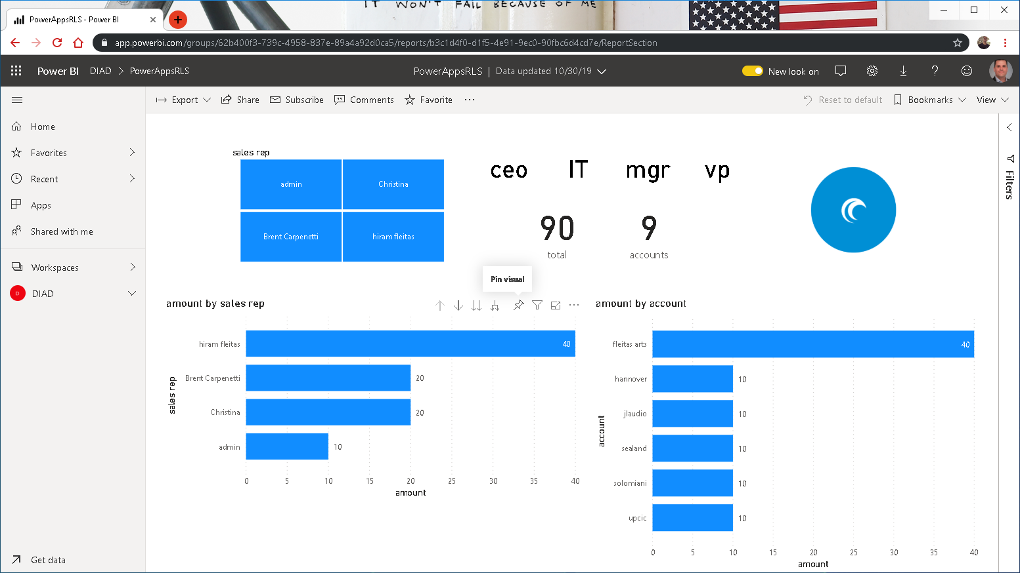

Slide 28


Slide 29
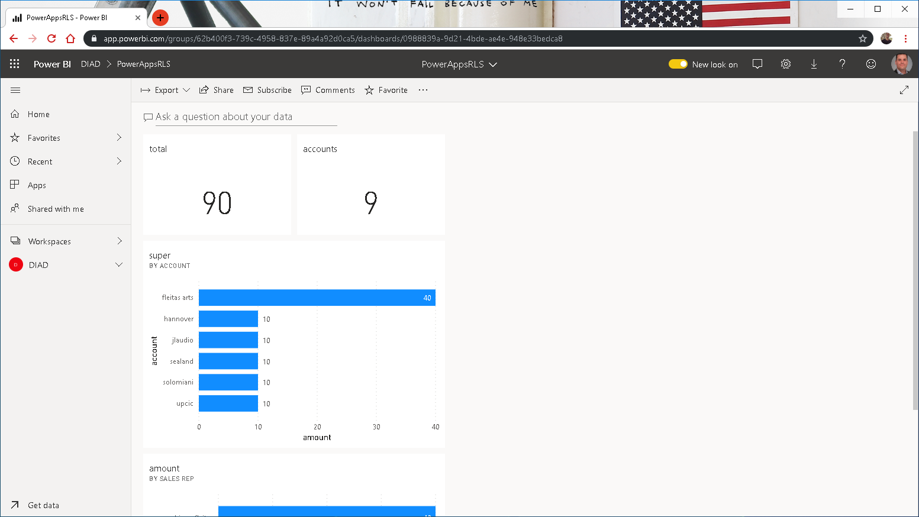

Slide 30
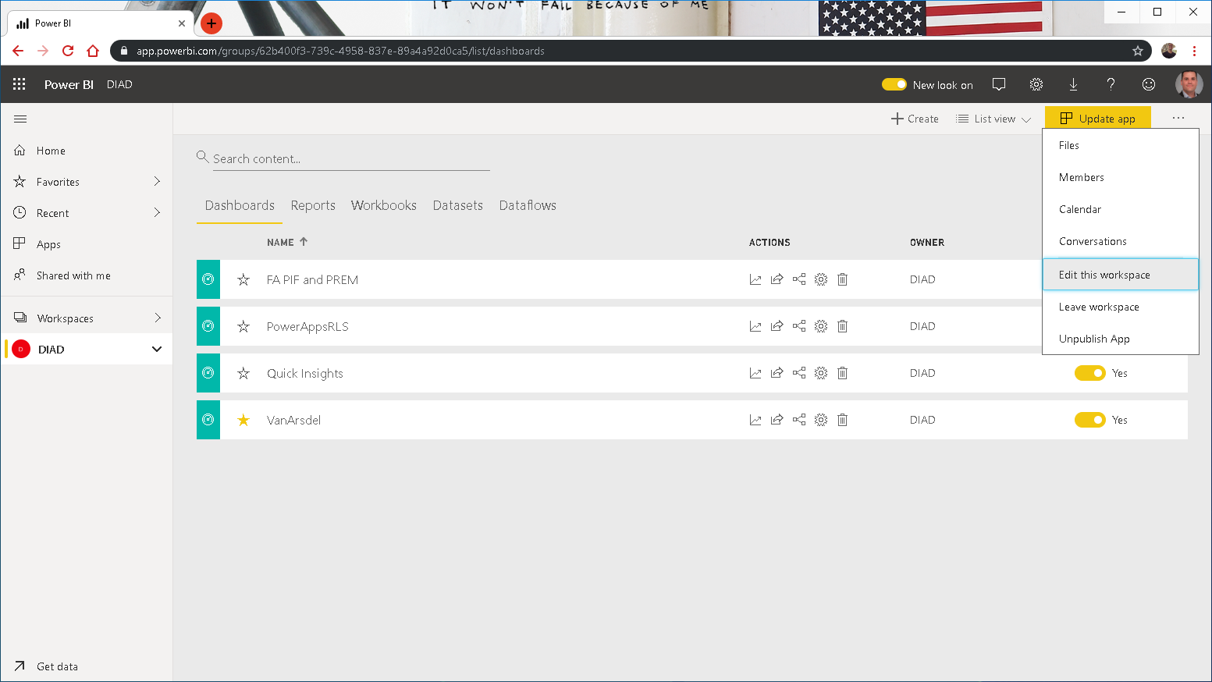

Slide 31
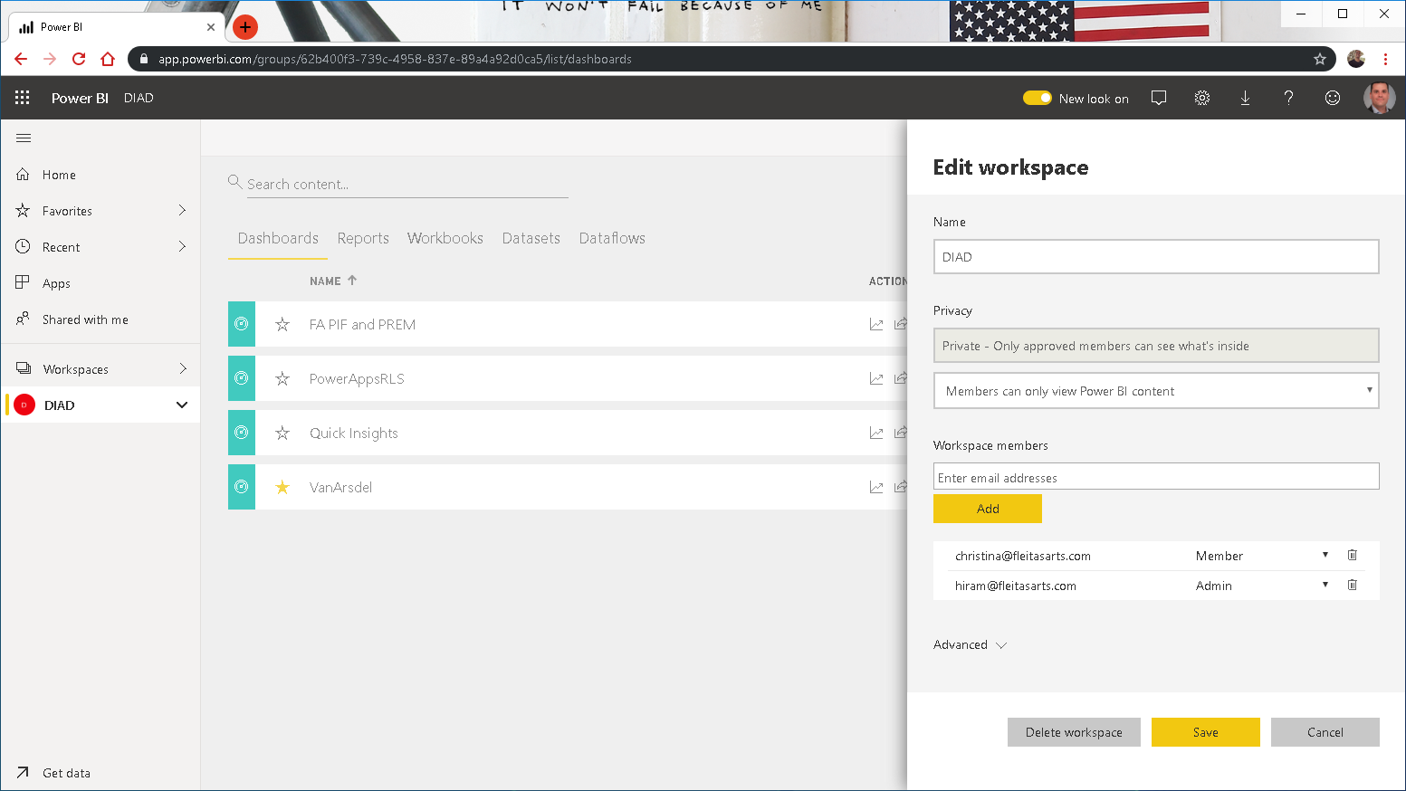

Slide 32
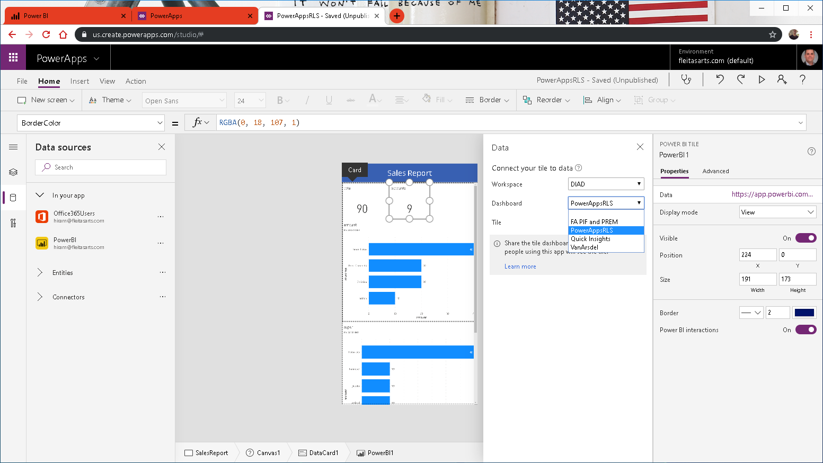

Slide 33
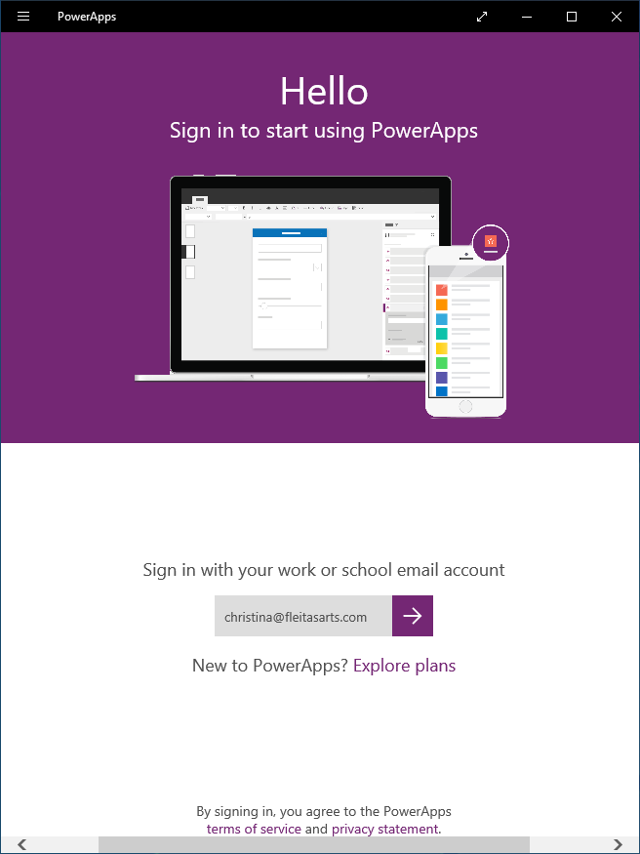

Slide 34
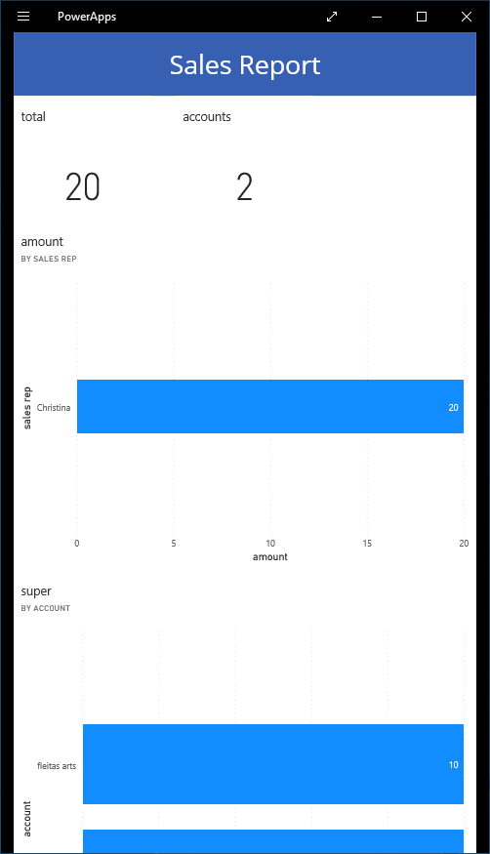

Slide 35
Approvals
three

Slide 36
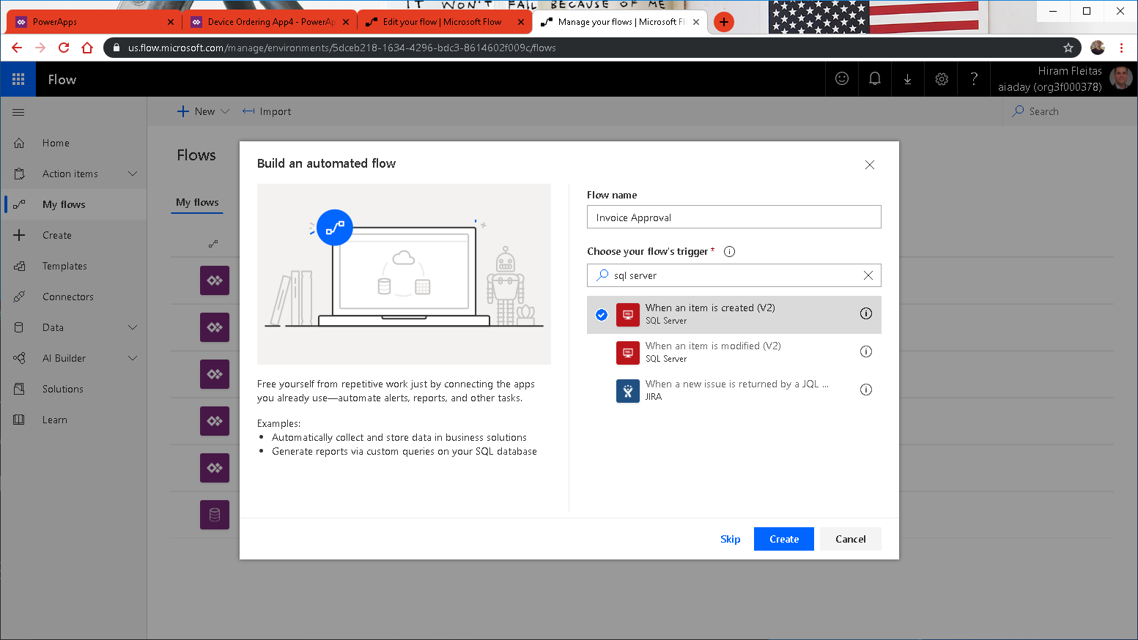

Slide 37
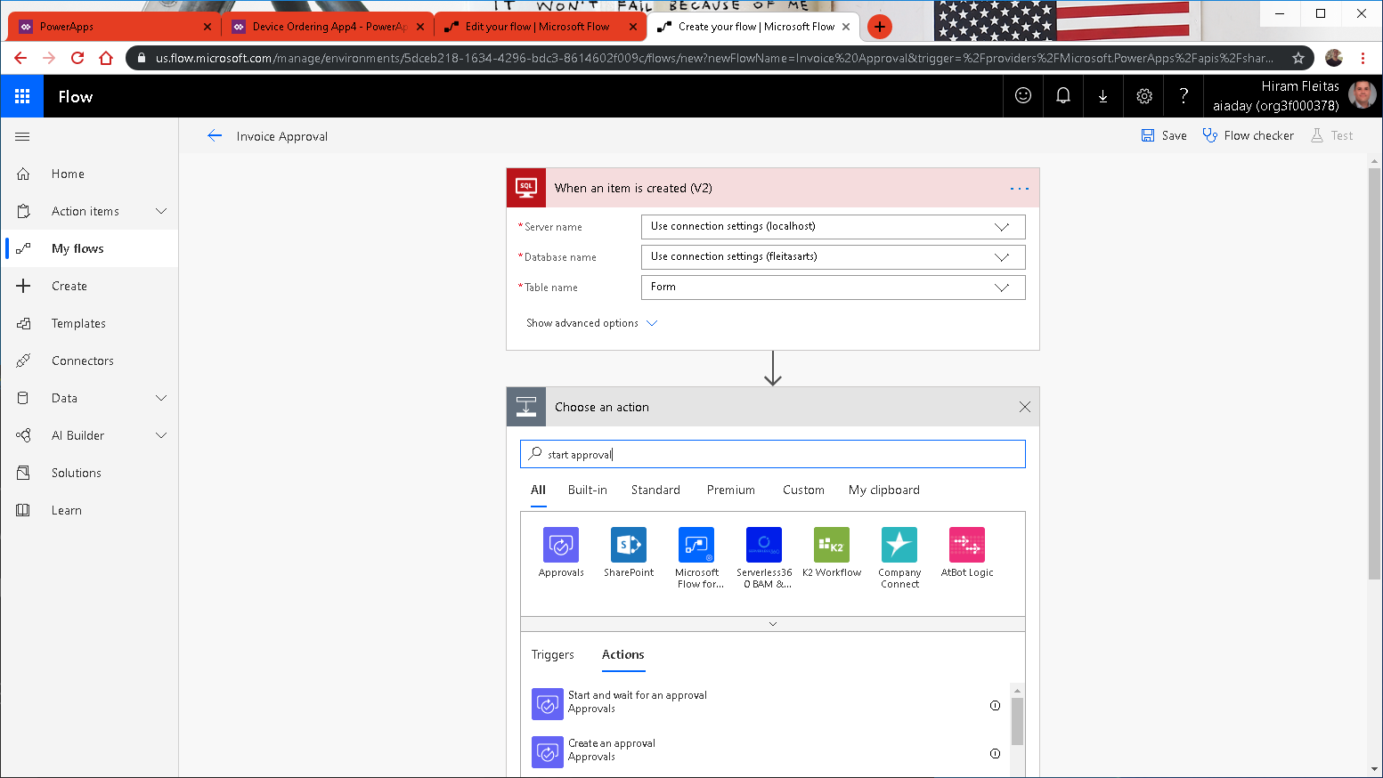

Slide 38
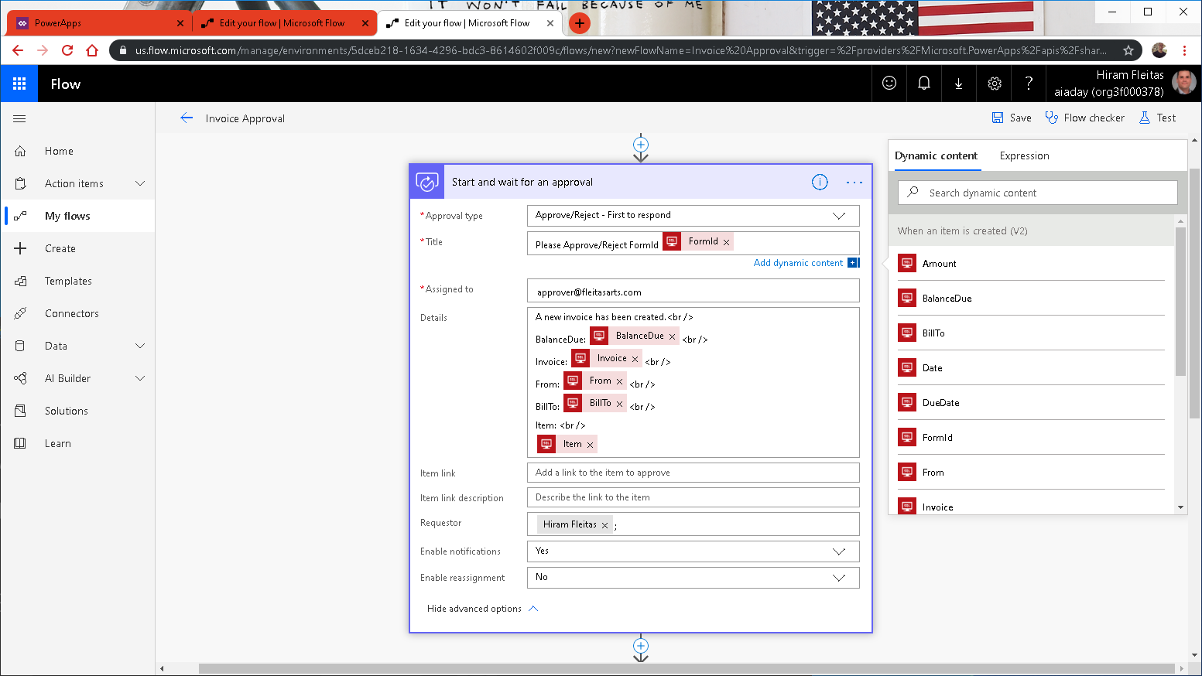

Slide 39
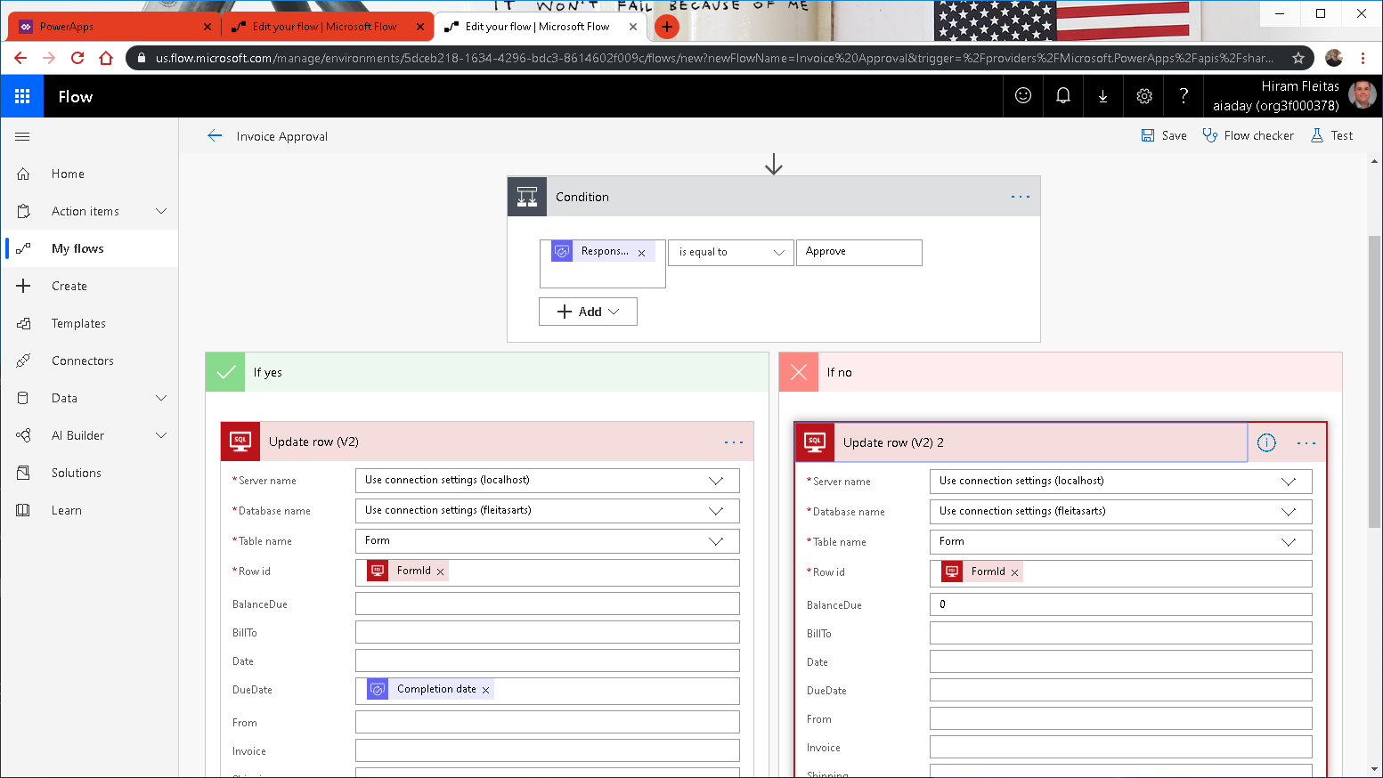

Slide 40
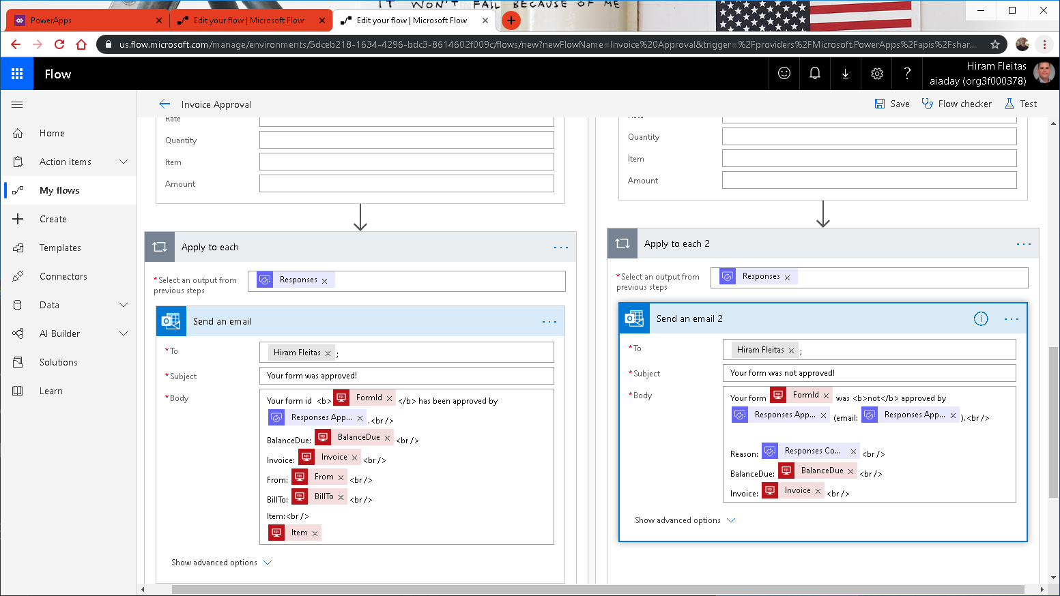

Slide 41
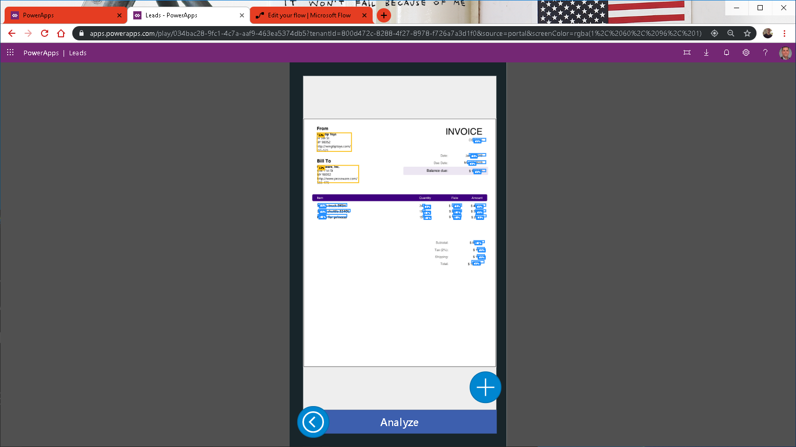

Slide 42
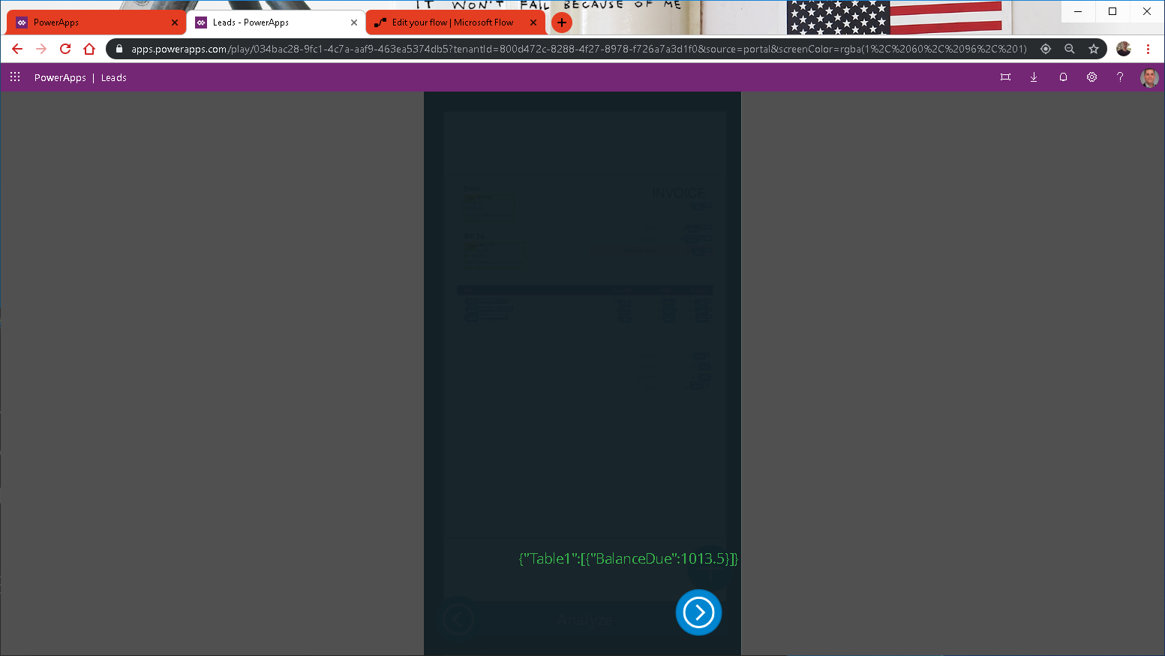

Slide 43
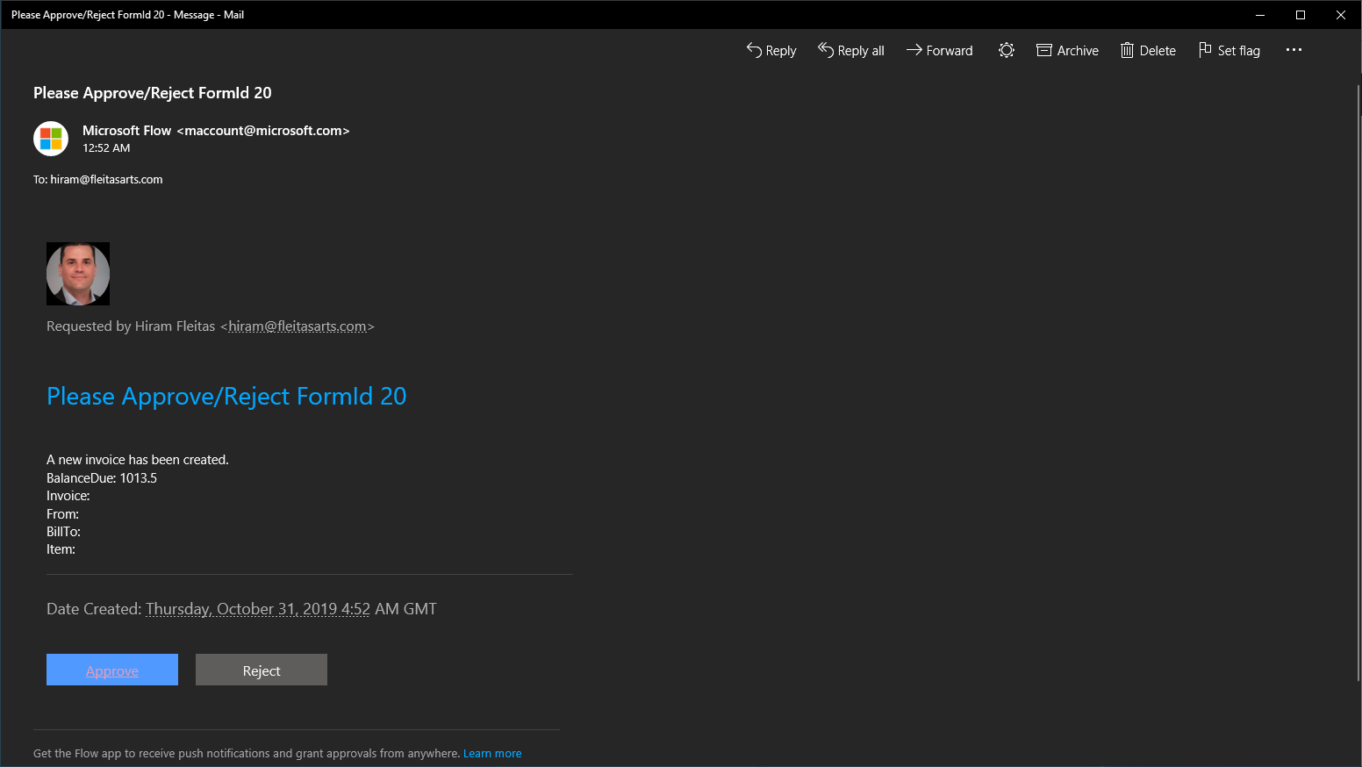

Slide 44
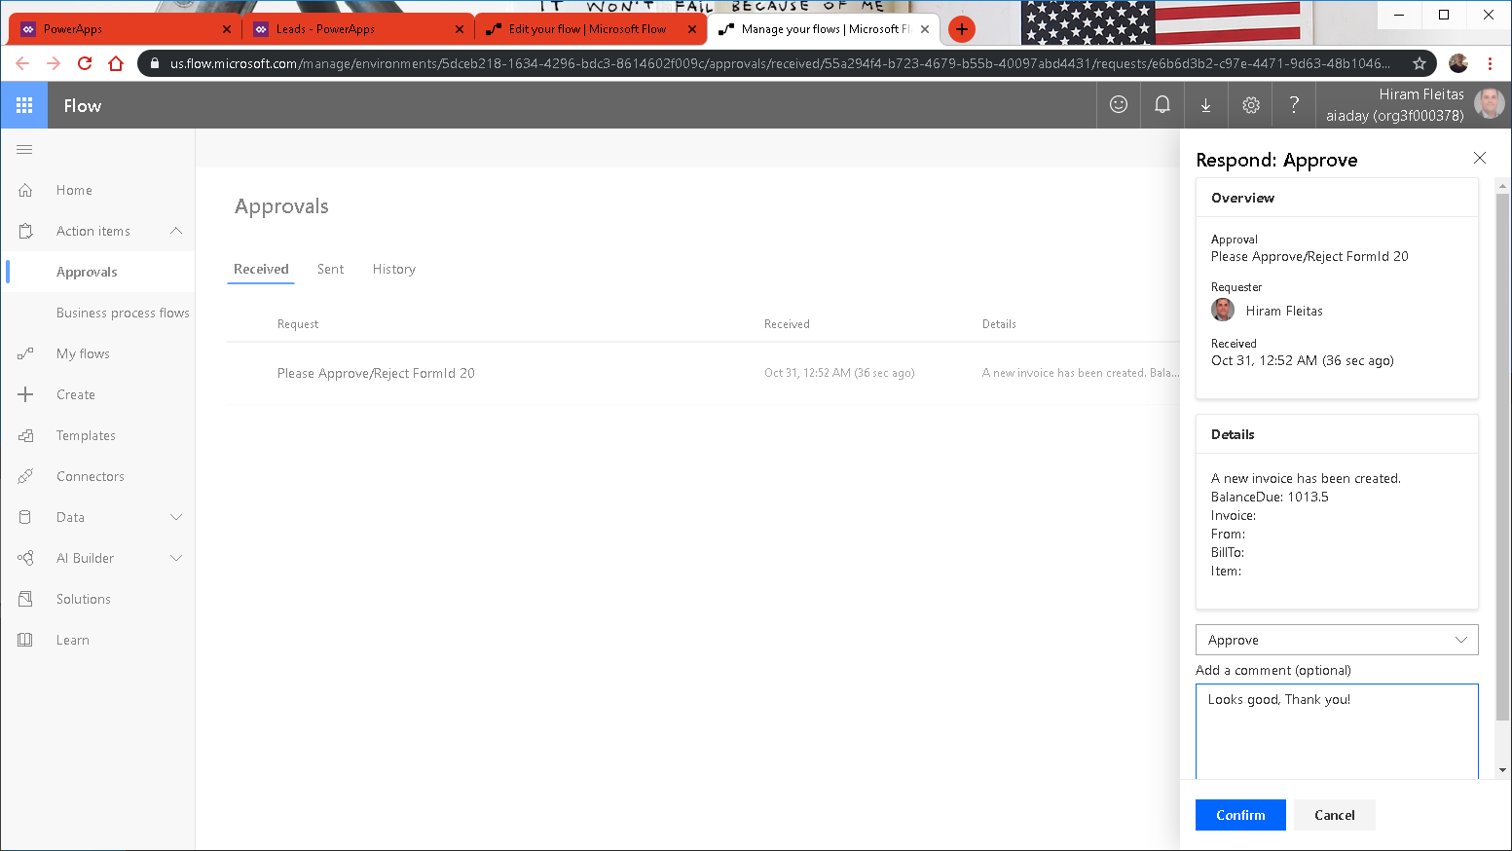

Slide 45
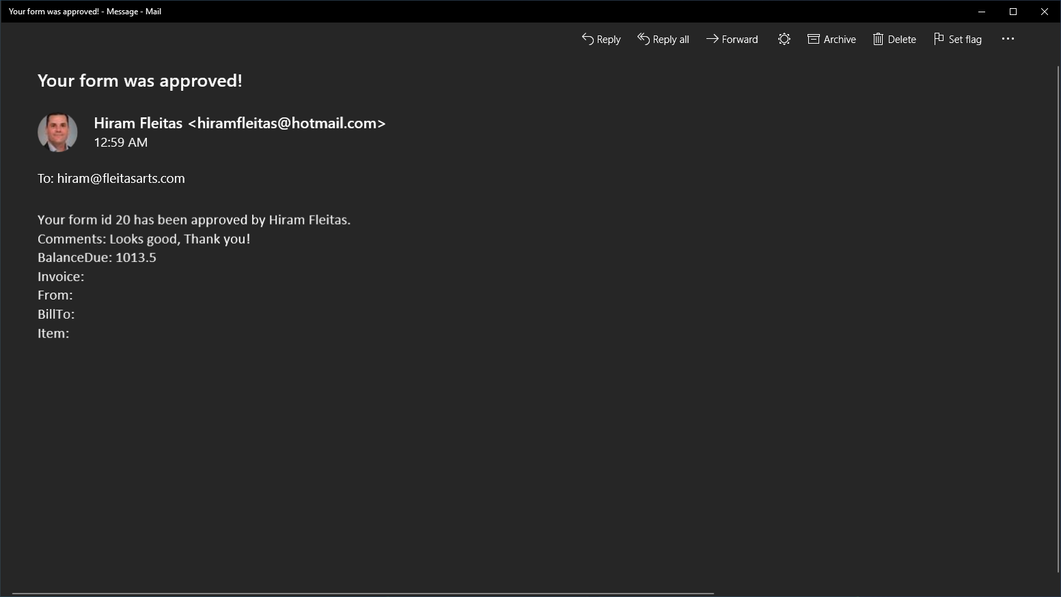

Slide 46
International Space Station
four

Slide 47
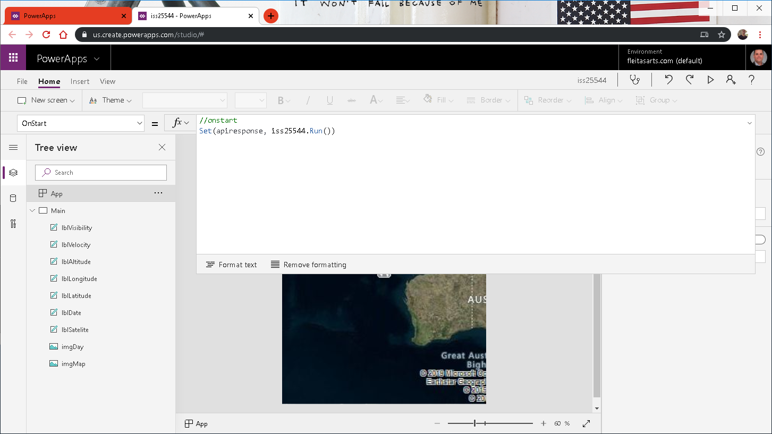

Slide 48
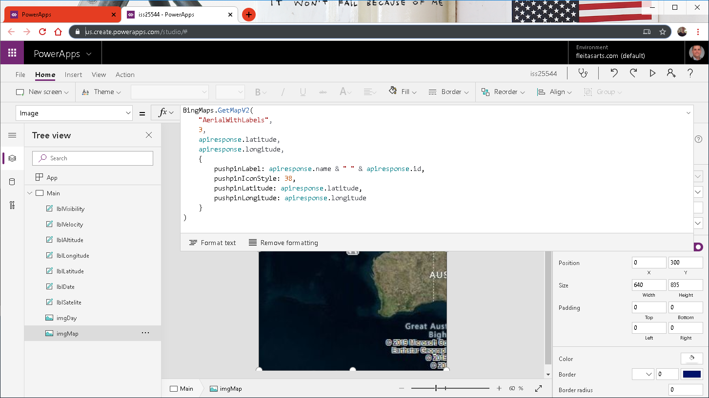

Slide 49
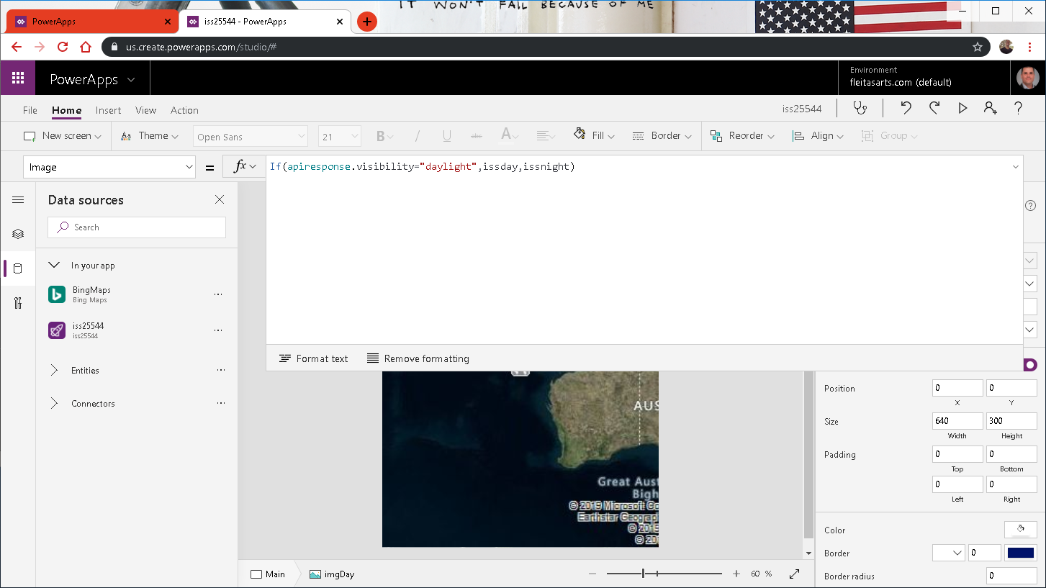

Slide 50
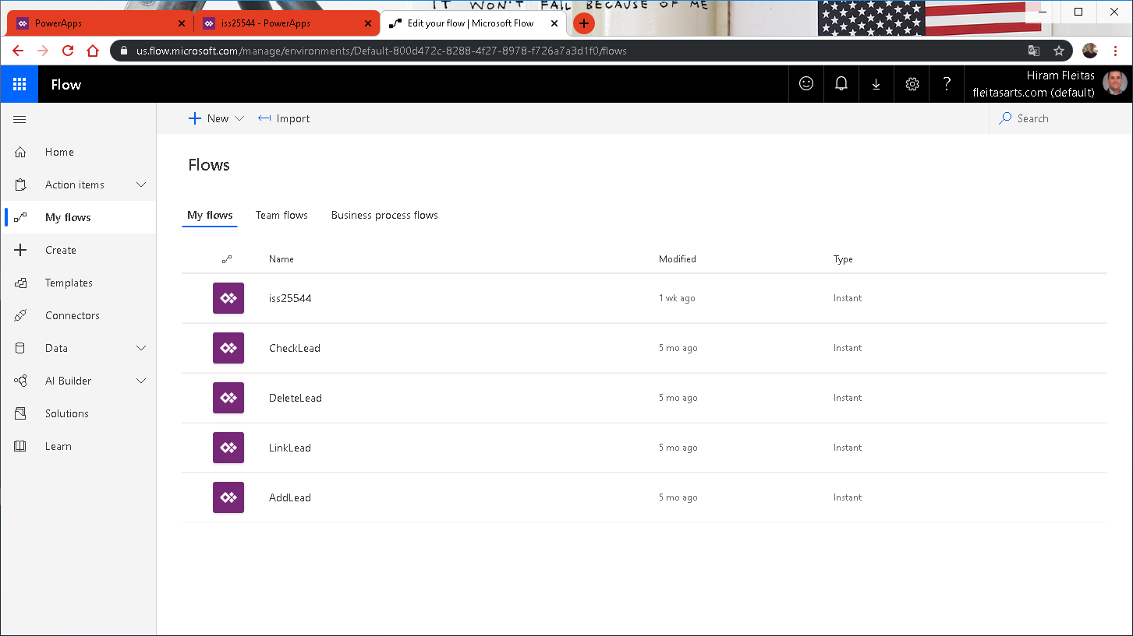

Slide 51
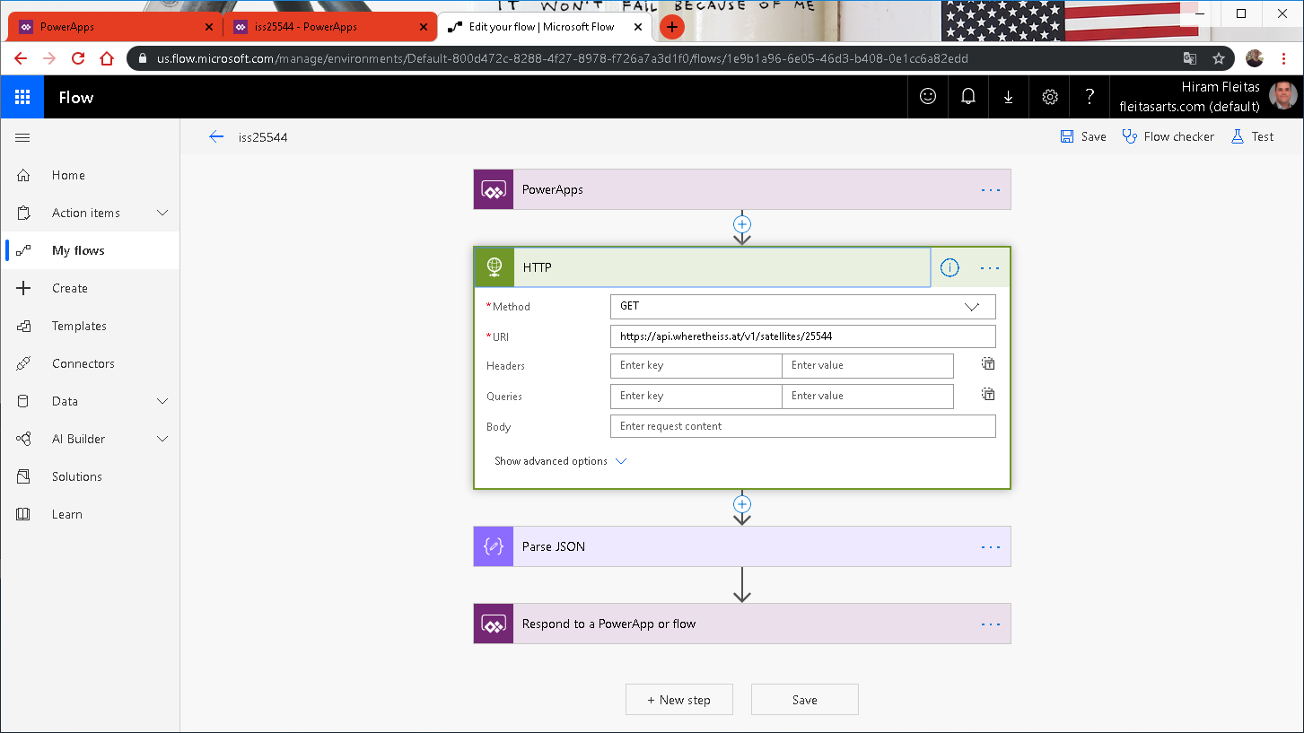

Slide 52
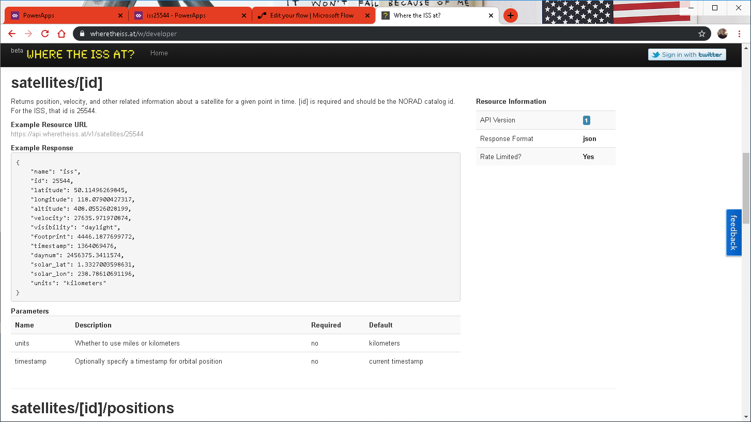

Slide 53
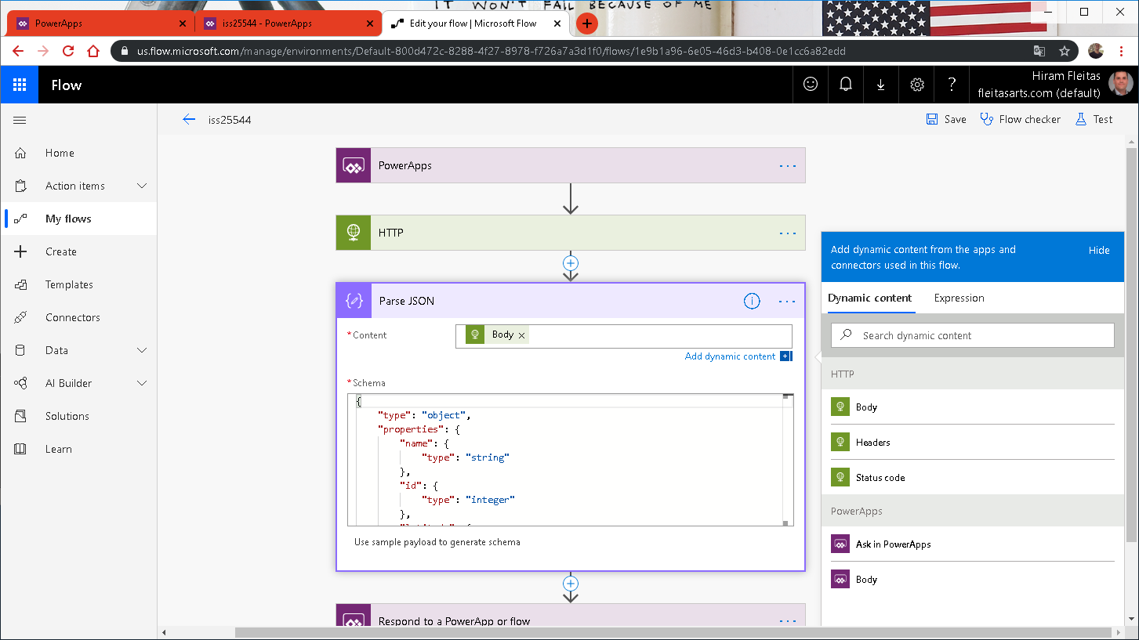

Slide 54
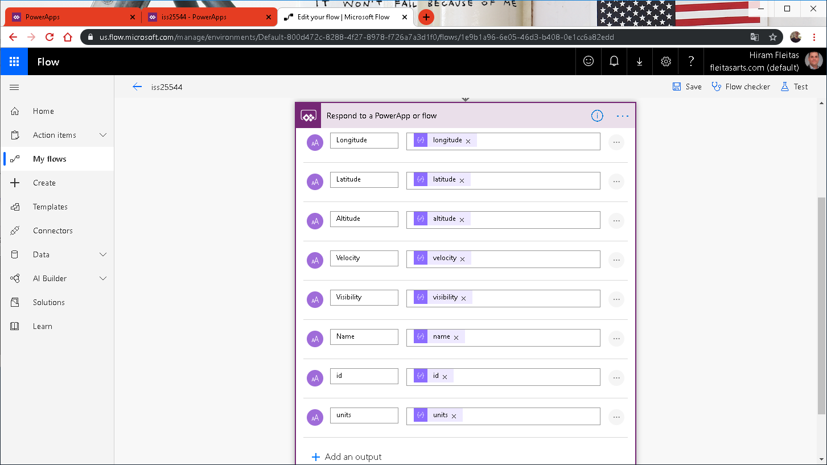

Slide 55


Slide 56


Slide 57


Slide 58


Slide 59


Slide 60
aka.ms/TryPVA
five

Slide 61


End

Slide 62
Summary
Ai Builder (Forms)
Row-Level-Security (RLS)
Approvals
ISS HTTP Web API
Power Virtual Agents

Slide 63
Resources
fleitasarts.com
github.com/hfleitas/pbifest2019
Microsoft Learn
Pricing
aka.ms/TryPVA
make.powerapps.com
ROI Case Study
Notes:
https://dba2o.wordpress.com/
https://docs.microsoft.com/learn/browse/?products=power-platform
https://docs.microsoft.com/power-platform/admin/pricing-billing-skus
https://youtu.be/swpjfIyXCNA
https://docs.microsoft.com/powerapps/maker/canvas-apps/add-scrolling-screen
https://youtu.be/rcrubFa8758
https://youtu.be/SaDEVOgOlYY
https://powerusers.microsoft.com/t5/General-Discussion/image-in-a-circle/m-p/9124#M4007
https://docs.microsoft.com/power-bi/service-cortana-intro
https://docs.microsoft.com/powerapps/maker/canvas-apps/open-and-run-a-sample-app
https://docs.microsoft.com/powerapps/maker/canvas-apps/webinars-listing
https://go.microsoft.com/fwlink/?LinkId=2005303&clcid=0x409
https://www.microsoft.com/en-us/businessapplicationssummit

Slide 64

Community
Power BI
PowerApps
Microsoft Flow
Data Stories Gallery
Discuss, Connect, Feedback
Notes:
https://powerusers.microsoft.com/
Data Stories Gallery
Discuss, Connect, Feedback

Slide 65
Link to Eval:
bit.ly/pbifest19
Your participation is very important.

Slide 66

Hiram Fleitas
Owner, Fleitas Arts
Thank You
@hiramfleitas
hiram@fleitasarts.com
fleitasarts.com
/hfleitas
hiramfleitas

